Slide 1
Assignment 3
Ubiquitous Computing Lab
Suryasaradhi Balarkan 1840580

Slide 2
Problem Statement
A automatic plant monitoring system that is capable of monitoring plant growth and watering the plant based on sensor inputs

Slide 3
Solution Implemented
Waters the plant based on Sensor data, an LLM takes the decision
Sensor Input Data:
Time (RTC clock)
Sunlight (LDR)
Moisture level (resistance sensor)
Plant Height
Temperature sensor
Sensor Output Data:
Switching the watering pump
Notification Alerts

Slide 4
Decision Summary
Temperature Warning: Trigger if temperature < 10°C or > 30°C.
Sunlight Monitoring:
Sum of non-zero sunlight readings tracked daily.
At day's end:
< 30 min → “Not enough sunlight” warning
5 hrs → “Too much sunlight” warning
Soil Moisture & Motor Control:
Moisture < 30% → Motor ON
Moisture ≥ 50% → Motor OFF
The decision system is not hardcoded instead done by the AI

Slide 5
Tools Used
Flask
Html + javascript + css
Ollama 3.2 (python binding)

Slide 6
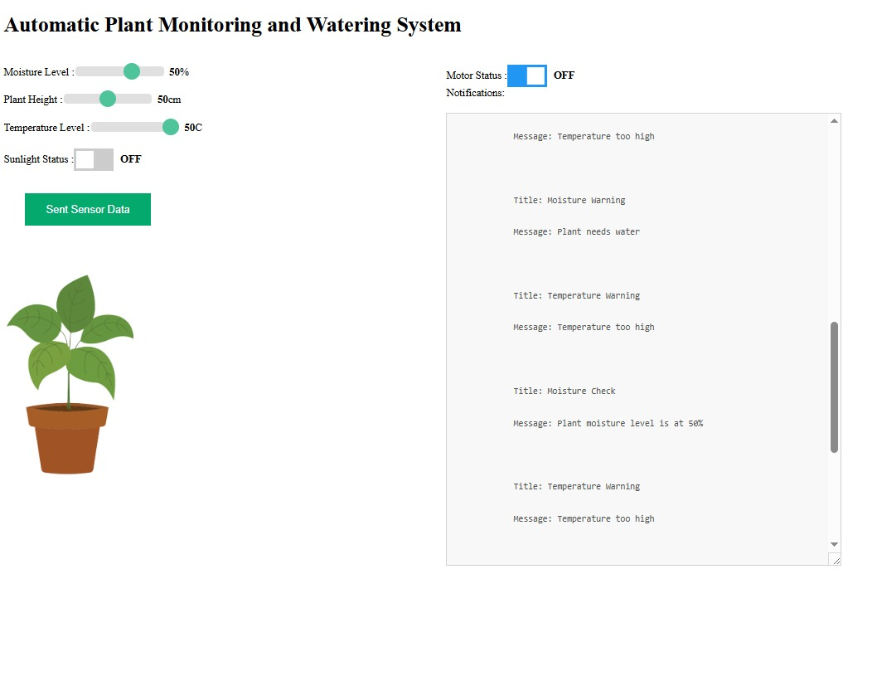
Demo :
To run the demo run
pip install –r requirements.txt
python main.py

Slide 7
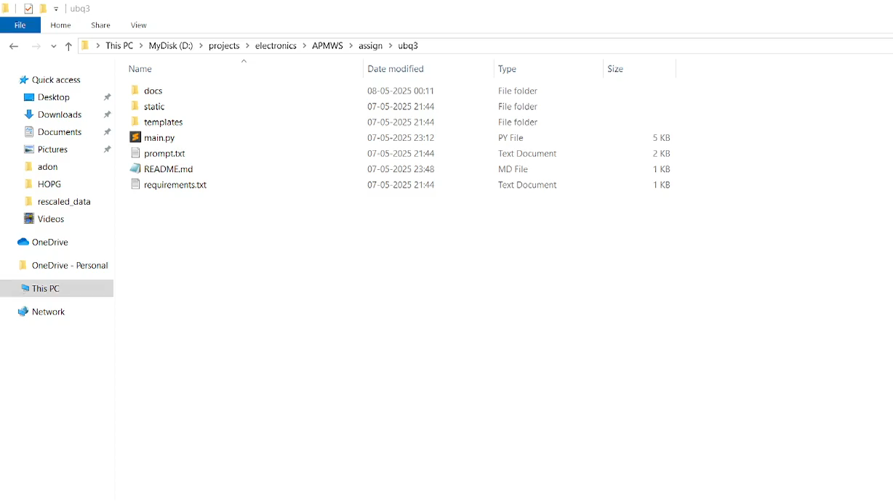
Explanation and Demo Walkthrough

Slide 8
Repository
https://github.com/thesunRider/APMWS/tree/master/assign/ubq3

Slide 9
THANK YOU

